Slide 1
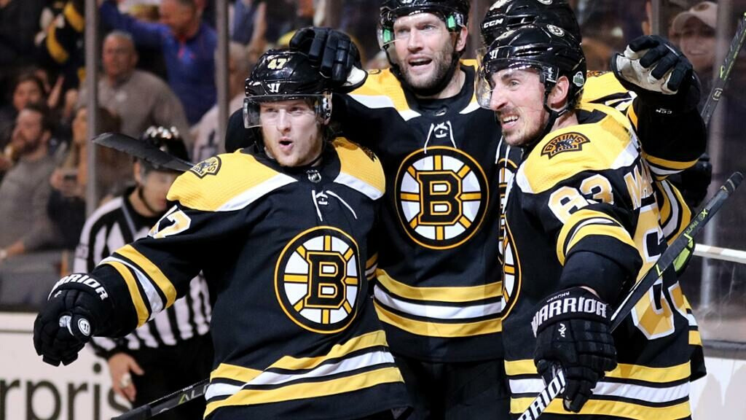


Predicting Team & Player Performance
Jenny, Joshua, Ray,
Anshuman, Peng.

Slide 2
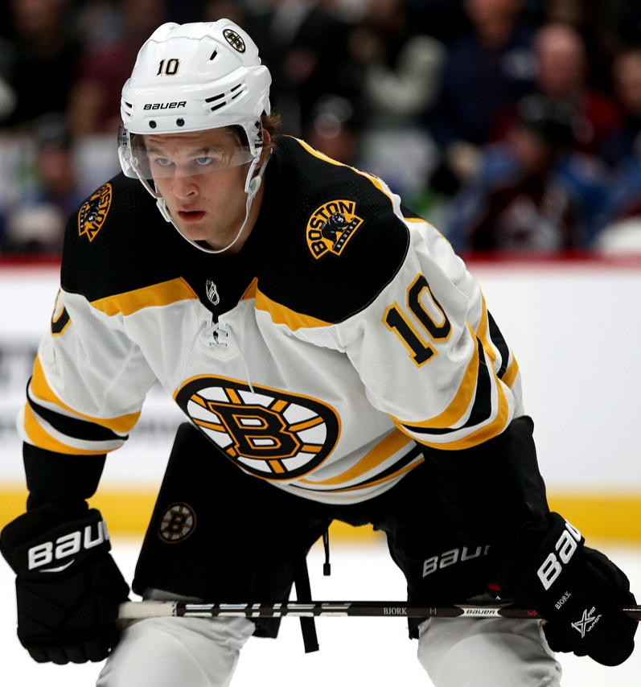
Objective
Question 1
Predicting Pts% for the next quarter for the Boston Bruins
Question 2
Predict Player performance for rest of the season (2019-20) & evaluate their next contract price. The two teams taken into consideration are Boston Bruins & Toronto Maple Leafs
.

Slide 3
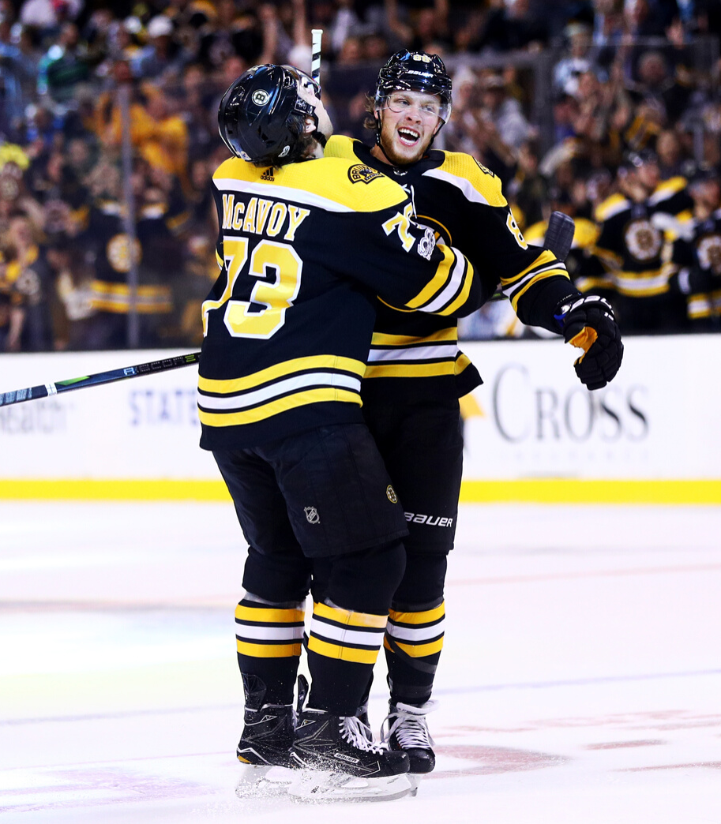

Question 1
Introduction
Team with more points during season is ranked higher
Predicting the number of points a team will accrue in a season is hard
Dataset contains 57 quarters of Percentage Points for Boston Bruins
This project introduces fundamental model of predicting a team’s percentage points over the next quarter season without any regressors
The future of the Boston Bruins is…?!
Notes:
Hockey is a sport of parity.
There are too many variables to consider to answer this question.
We have a small dataset.

Slide 4
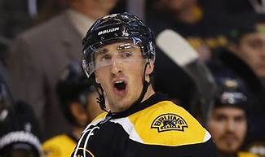
Question 1
Data Characteristics
The future of the Boston Bruins is…?!
Source, Outliers, Trends & Patterns
Modeling
STL Decomposition, Naive Model, ETS Model, Bagging
Conclusions
Key Findings & Limitations
Notes:
Three sections

Slide 5

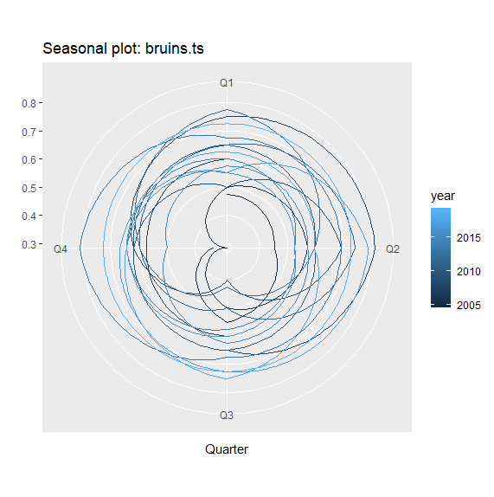

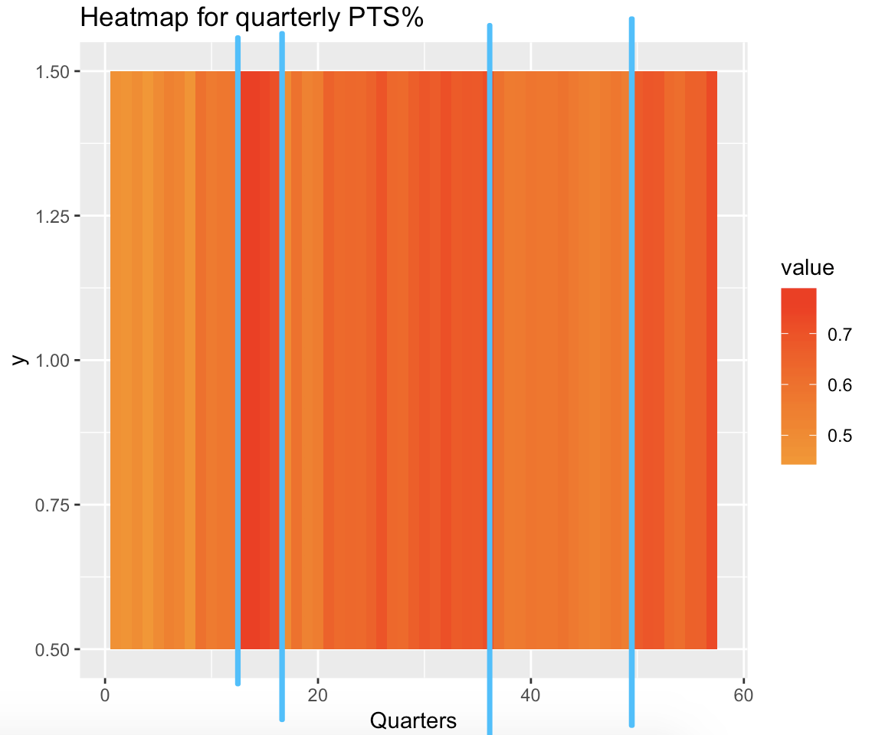
Data Characteristic
Checking Trends & Seasonality
Polar Plot : No Trend Observed. Difficult to conclude if Bruins is playing better or worse over the course of time
Heatmap: 5 segments can be separated on the basis of color. Each color showing different levels of performance (Average, Above average, Extremely well etc)
Notes:
Over the last few years, the Bruins have been considered a Stanley Cup Contender, a legitimate choice for winning the championship.
Before the arrival of current greats like Patrice Bergeron, David Krejci, and Brad Marchand, the Bruins were a void of hockey talent.
Polar plot also hints at team performance from the area within color bands, with a larger area meaning better performance in season.
Heatmap tells the story of the different eras of Bruins Hockey. The dark strips in the middle of graph represent the time when the Bruins won the championship in 2011 and returned to the finals in 2013.

Slide 6
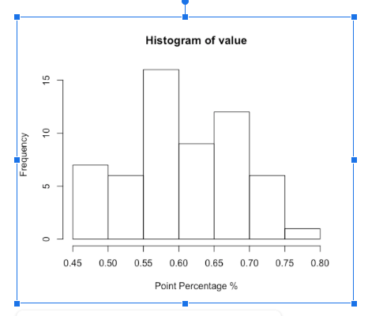
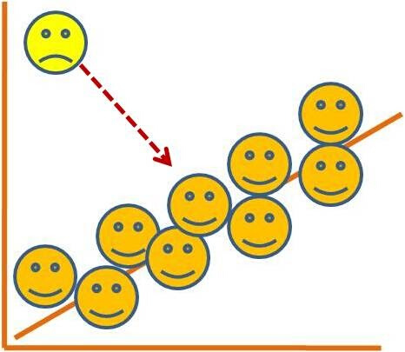
Data Characteristic
Season 2012-13 Anomaly: Dispute between league & players association.
38 games were cancelled
Entropy: 1.19 without noticing error.
Averaging 2 quarters entropy dropped to 0.96 (20% decrease)
Outliers:Most values in Histogram range from 0.45 to 0.8
TS Outliers confirms !
Notes:
2012-2013 labor dispute
Entropy went down 20% by taking an average of the year before and the year after and imputing the two missing quarters
No outliers. Despite the league’s reputation for parity, somehow the Bruins have been outperforming the league on average.

Slide 7
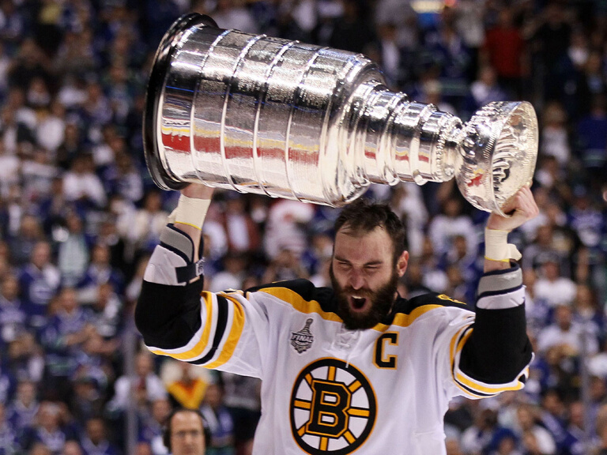
Modeling
Tests of Non-linearity
P-Value of most tests >0.05, "indicating a non-linear model is not necessary"
Transformation
Box- Cox lambda , parameter generated is -0.0731
Testing Set
2 Observations taken for Testing Set
Goal is to forecast Points % for next quarter
Box- Cox lambda , parameter generated is -0.0731
Notes:
Non-linear model is not necessary
Transformation so that response variable will rest between 0 and 1
Testing set is small because dataset has a small number of observations

Slide 8
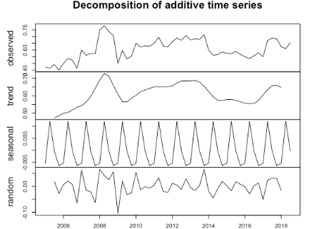
Naive Model
Created to Benchmark for comparison purposes
STL Decomposition
No clear upward or downward trend
Yearly Seasonality observed
Accuracy measures are saved & compared later

Slide 9
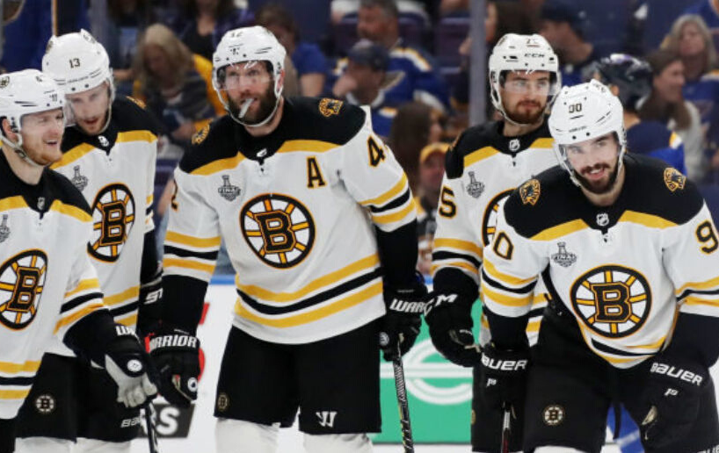
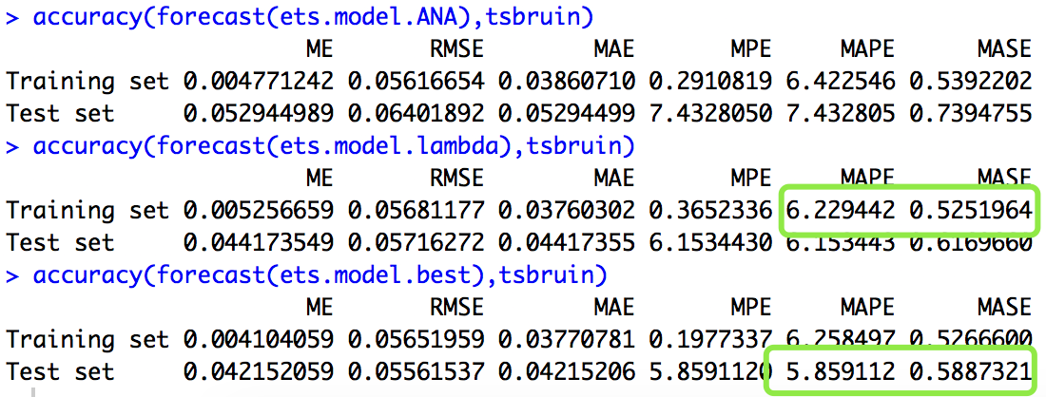
ETS Models
Best ETS with log-transformation is the best candidate for prediction
ETS Comparison
ETS(A,N,N) lambda = -.07
ETS(A,N,A)
ETS(M,N,N)
Model | ANA lambda = -0.0731 | Best.ETS lambda = -0.0731 | Best.ETS
Sigma | 0.1018 | 0.0987 | 0.0952
AIC | -23.279590 | -30.33123 | -91.17163
Forecast Interval | 0.2471858 | 0.2432969 | 0.2432969
ETS (A,N,A) : Largest MAPE, MASE & AIC
Best ETS with no Lambda assigned:
Best Testing MAPE & MASE
Smallest sigma, AIC
Tight Forecast Interval

Slide 10


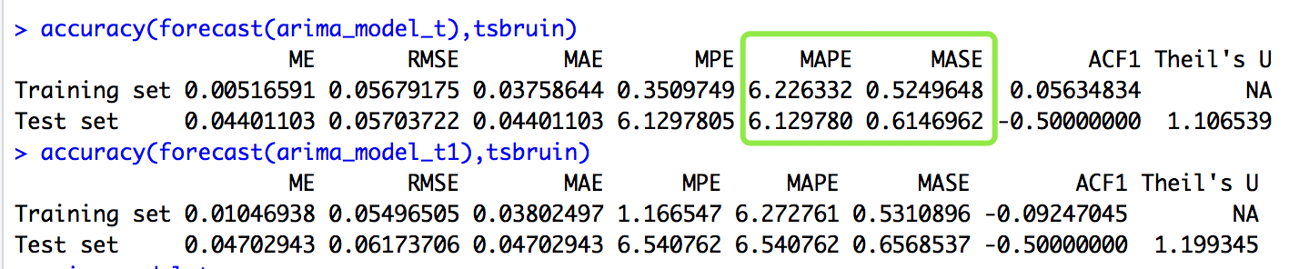
ARIMA Models
ARIMA (1,1,1)
Created using brute force method giving R total freedom
1 lag difference is taken to make the model stationary, then one value and one error from previous quarter are referred to generate the next forecast
ARIMA (0,1,1)
Second model with lambda =-0.0731 generated a (0,1,1) model
Better MASE and MAPE value
Smaller MSE for rolling window CV

Slide 11
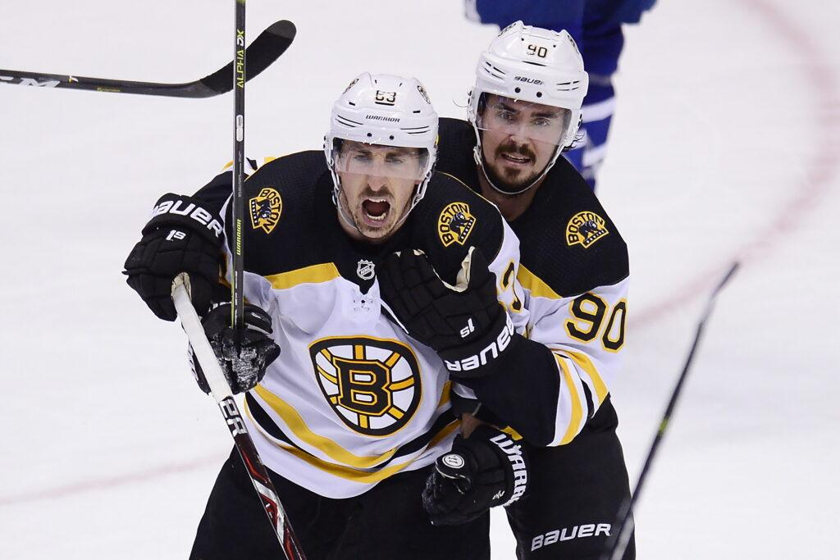
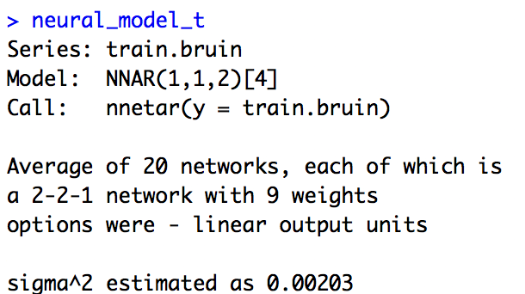
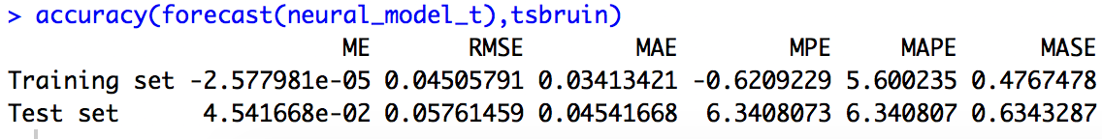
Neural Networking
NNAR(1,1,2)[4]
1 original difference, 1 seasonal difference, and 2 hidden nodes are used for this quarterly dataset

Slide 12
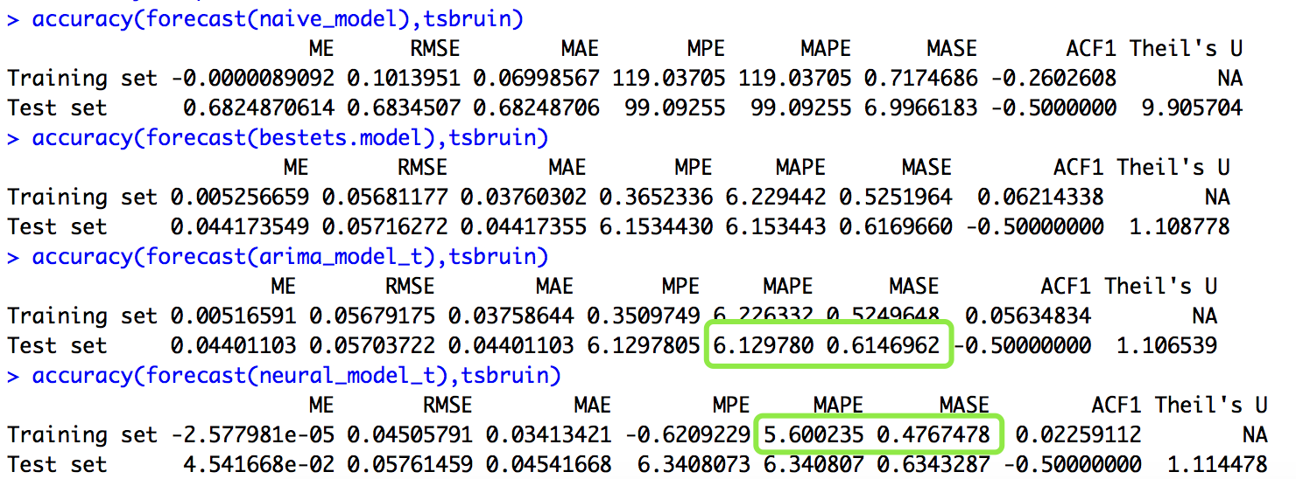

Model Comparison
4 Models are compared : Naive, ETS, ARIMA & Neural Network
ETS(M,N,N)
ARIMA(0,1,1)
Neural Network(1,1,2)[4]

Slide 13
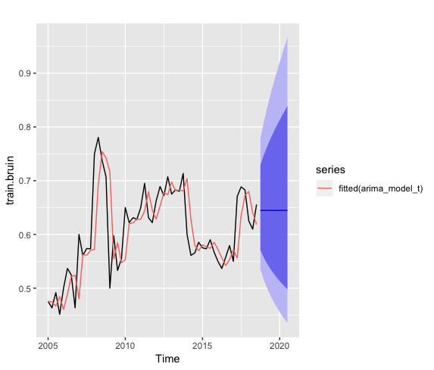
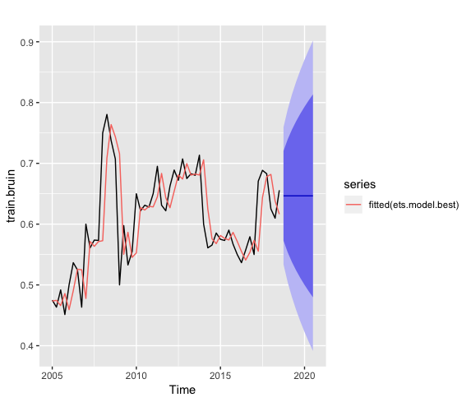
Weakness: Wide Prediction Interval

Slide 14
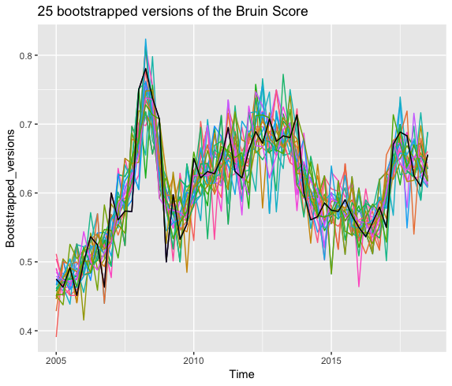
Bootstrapped Aggregating
Compare with the best model
(ARIMA model)

Slide 15
Bootstrapped Aggregating
Compare with the best model
(ARIMA model)

Slide 16
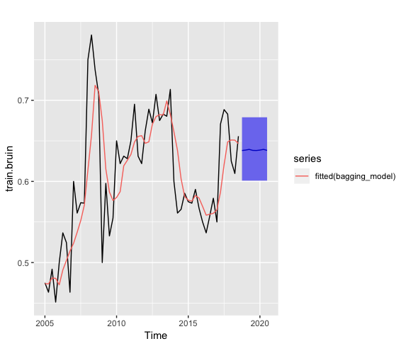
Bootstrapped Aggregating Comparison
95% Average
Forecast Interval(P1)
[0.5204986, 0.7466899]
Range = 0.2261913
95% Forecast Interval(P1)
[0.5352211, 0.7785893]
Range = 0.2433682

Slide 17
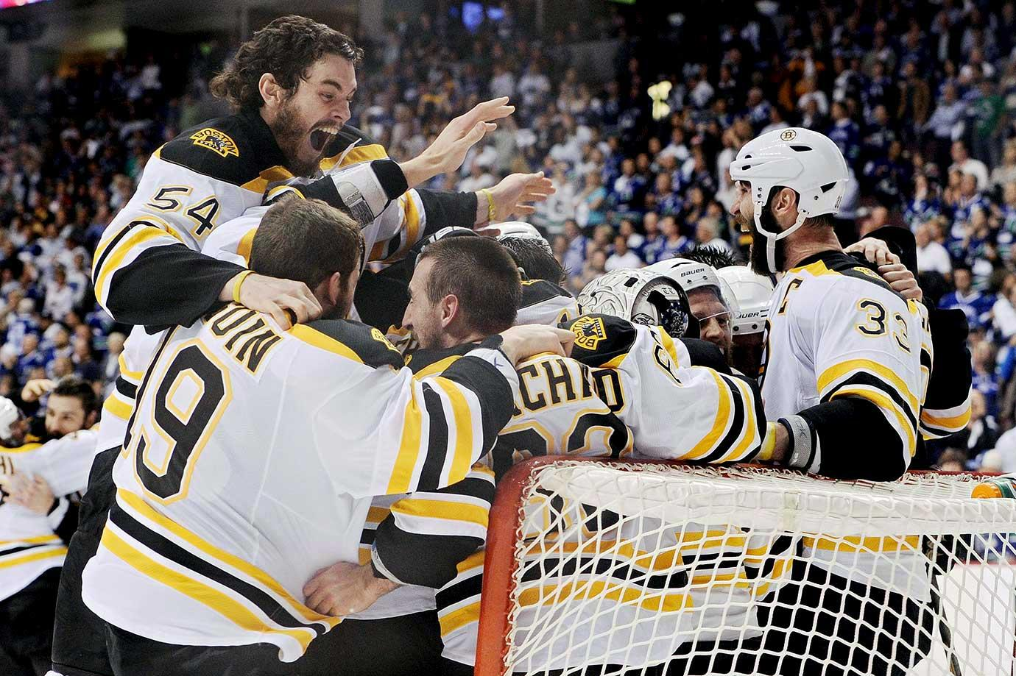
Bootstrapping Wins
95% Average
Forecast Interval(P1)
[0.5204986, 0.7466899]
Range = 0.2261913
Model-Free
Data-based(no parameter)
Independent Residuals

Slide 18
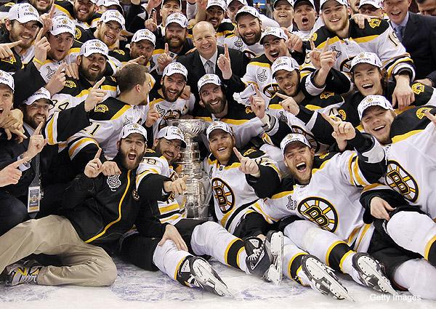
Future Roadmap
Expanding Analysis
1
Forecasting Games
Adding Observations
2
More Information
Causal Regressors
3
Enhance ARIMA Models
Notes:
Take forecasts for each team based on their historical performance game by game, adjust for difficulty of opponent, and simulate a season.
Helps data hungry models like Neural Network, but overall can allow a larger training set which is better for accuracy as long as the historic data is relevant.
Many interesting variables could be causal regressors, such as strength of opponent per Season, or aggregate Salary of roster players, etc.

Slide 19

Analysis Critique
Did not account for roster changes
Did not include interesting parameters
Could dig deeper into interesting finds
Notes:
Roster changes happen every year, and the loss of a good player or trading away a player who was well liked can cause slumps in performance.
Interesting parameters like hot streaks, injuries, home ice advantage, etc.
Look into the heatmap, what caused long stretches of average performance, great performance.

Slide 20
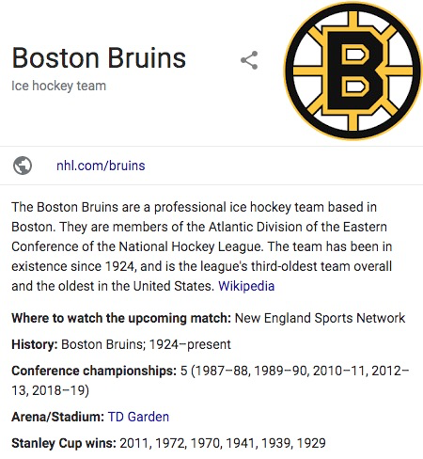
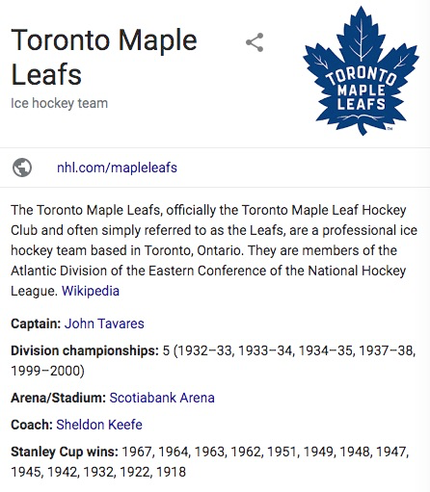
Question 2
Introduction
Predict Player performance for rest of the season (2019-20)
Evaluate their next contract price
2 teams with different salary STRATEGIES.
Team first vs. Young star players
$30 millions for the top 5 in Boston vs. $42 millions for that in Toronto
Methods:
TOI autoplot
Polar map
PACF
Non-linearity check
Model comparision

Slide 21
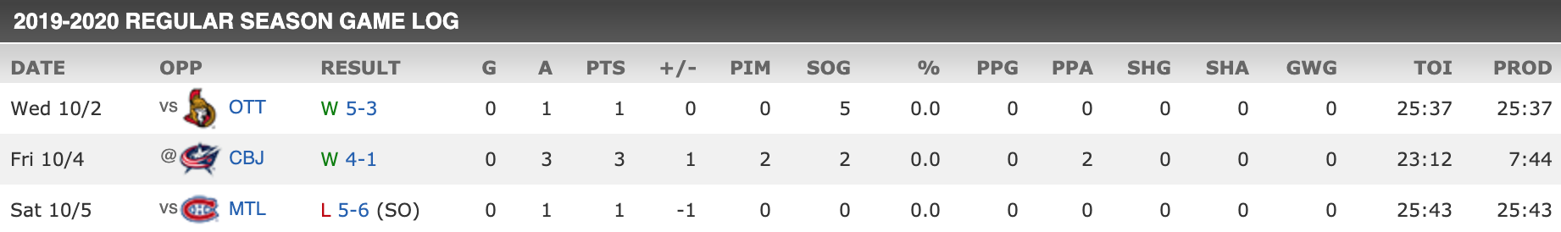

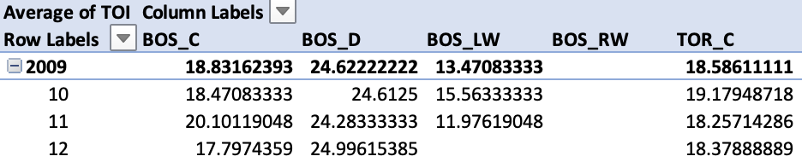

Game Log
Calculate the monthly average of TOI (time on ice)
Fill out missing by the average TOI of last 4 months
Removed the records of season 2012-2013 with just four month
The 2012–13 NHL season was the 96th season of operation (95th season of play) of the National Hockey League (NHL). The regular season began on January 19, 2013 and ended on April 28, 2013, with the playoffs to follow until June. The season start was delayed from its original October 11, 2012 date due to a lockout imposed by the NHL franchise owners after the expiration of the league's collective bargaining agreement (CBA).
5. Identify and replace outlier
tsclean(player.ts, lambda = ‘auto’)
DATA DIAGNOSTICS
How we deal with our data?
Data Cleaning
data preprocessing
Problem
null columns
lack seasonal recording

Slide 22
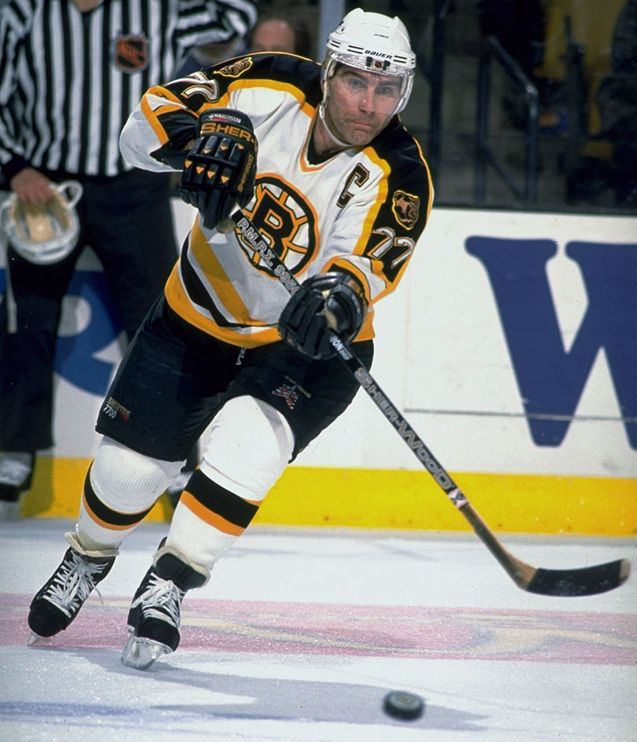
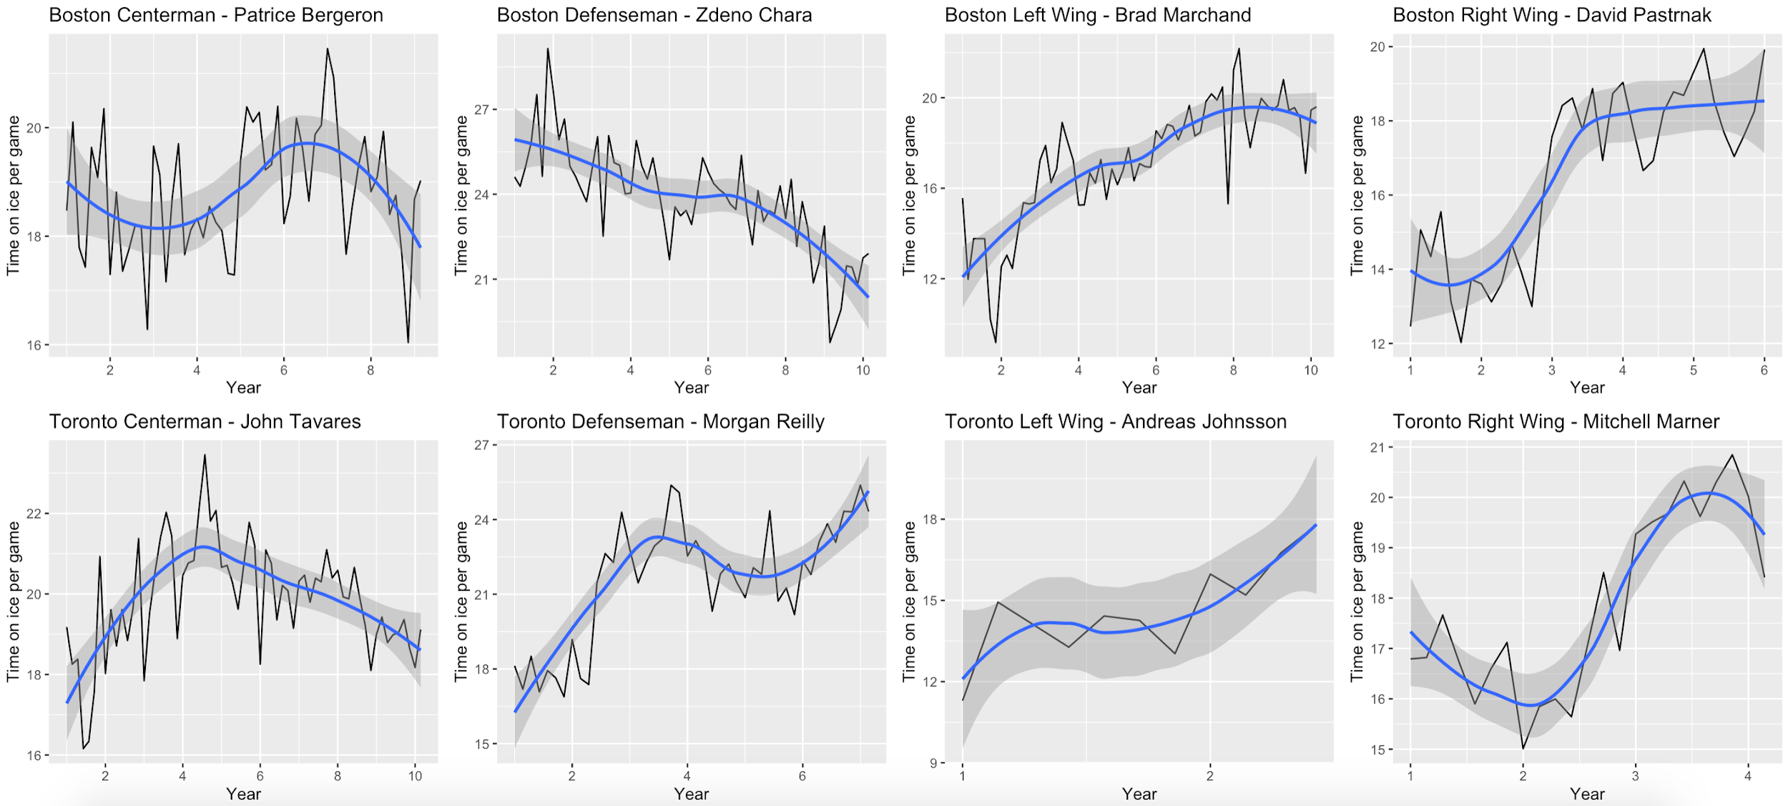
What is Time on Ice - TOI?
Ps: defenceman on the top two pairings will generally log the most amount of time on ice usually around 20+ min while the top forwards on the team will log around 17-21 min per game.
Measures
Total amount of time a player is on the ice during the playing of the game
Indicator
How a coach views the player and their contribution with more time going to players considered to be producers either through point production or point prevention

Slide 23
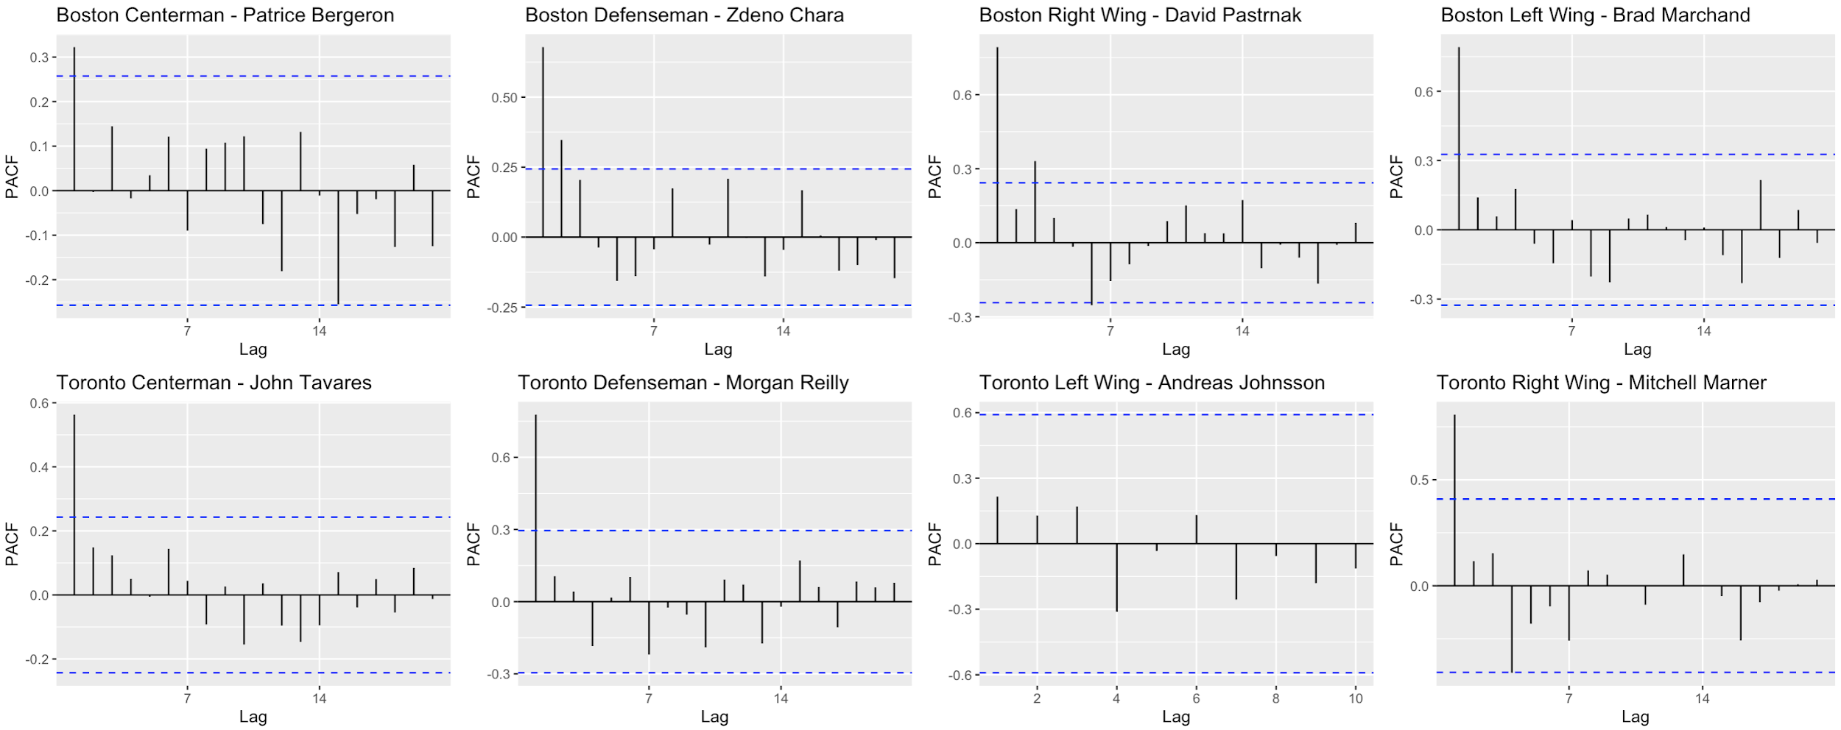
PACF plot analysis
Strong relationship between the performance in neighbouring months
Significant lags are all at 1
Not enough data for new player to show relationships

Slide 24
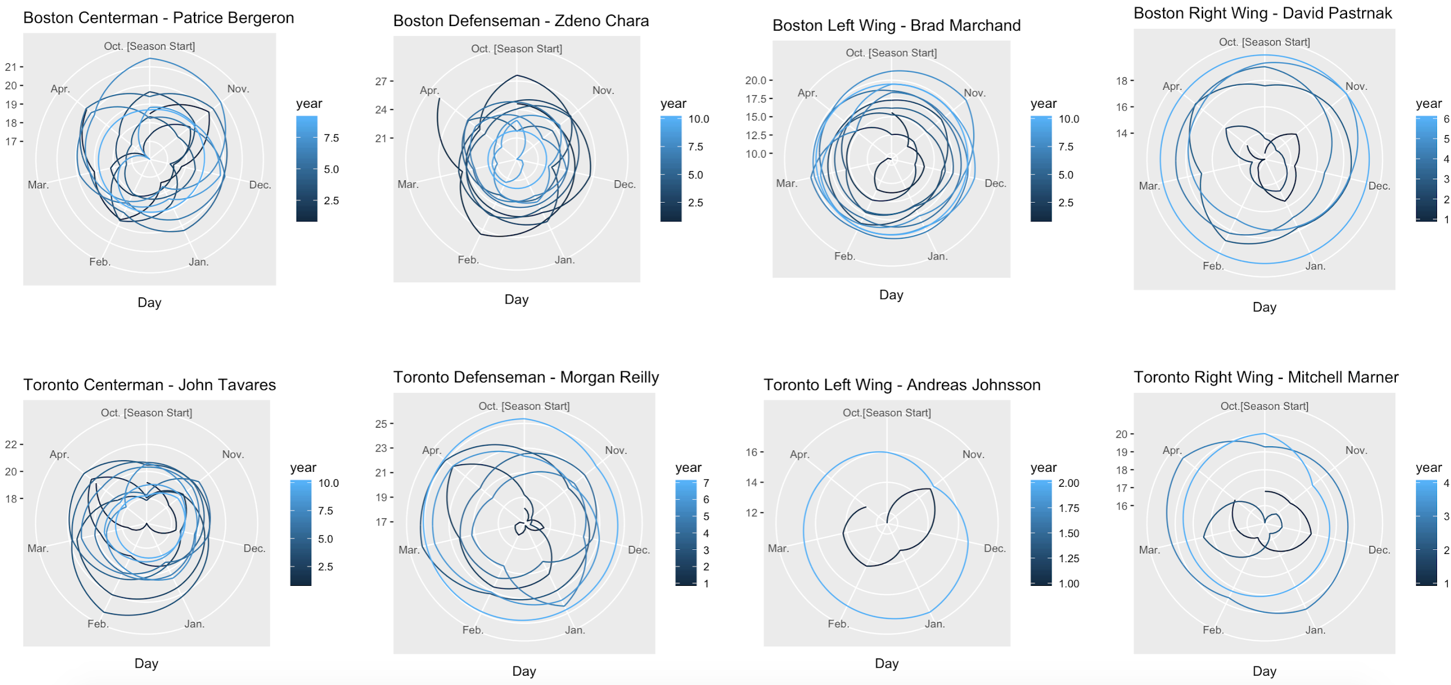
Seasonality Analysis
Polar maps of the performance of 8 players in Boston Bruins and Toronto Maples
Seasonality is the presence of variations that occur at specific regular intervals less than a year, such as weekly, monthly.
we could see:
which month has better performance
seasonal performance stationality

Slide 25

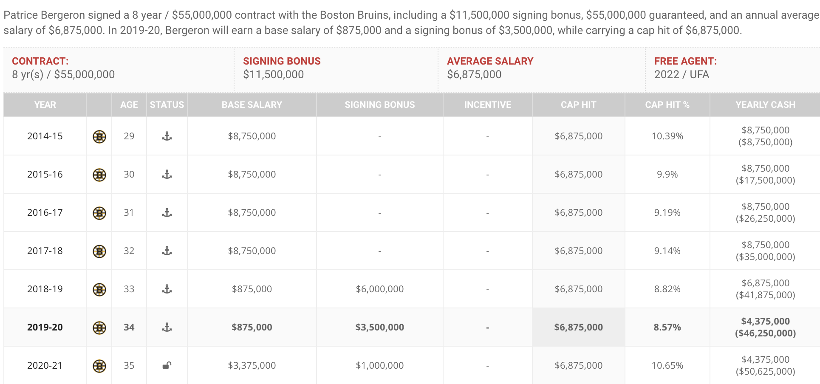



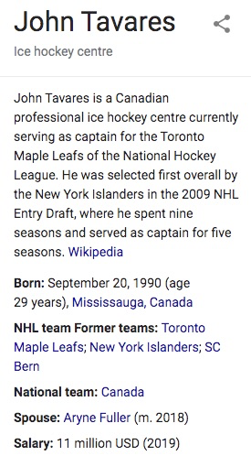
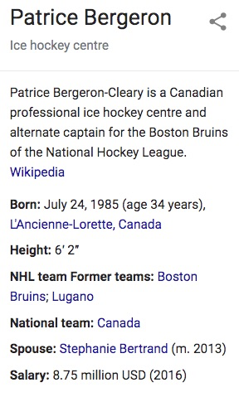
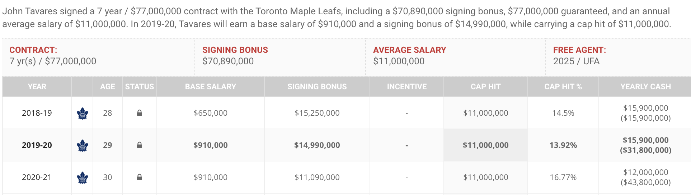
Salary Compare

Slide 26
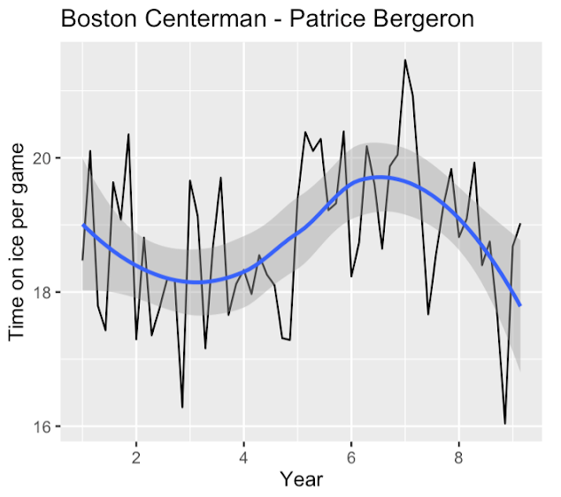
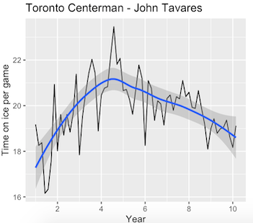
Performance Compare
18 ~ 20 min per game
Estimated time on ice
16 ~ 22 min per game
Estimated time on ice
stable
Peak
fluctuate performance in seasons
better at season beginning
more stable in seasons performance
better during middle season (February)

Slide 27
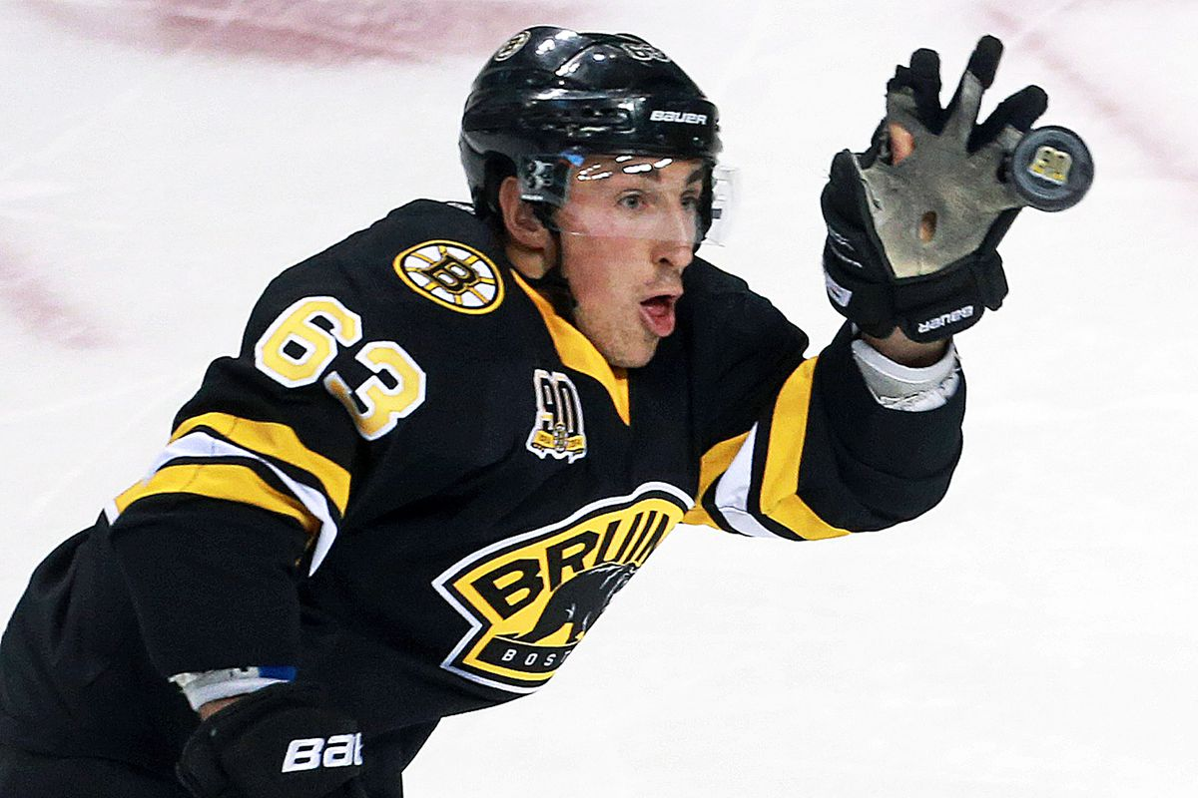
Modeling
Tests of Non-linearity
P-Value of most tests < 0.05, "indicating a linear model is improper"
Transformation
Box-Cox method
We applied the parameter, lambda="auto", to each model
Testing Set
1-year observations taken for original time series

Slide 28

Boston Centerman - Patrice Bergeron passed 5/6 tests
Boston Defenseman - Zdeno Chara
passed 4/6 tests
Toronto Centerman - John Tavares passed 4/6 tests
Toronto Defenseman - Morgan Reilly passed 3/6 tests
Tests of Non-linearity

Slide 29
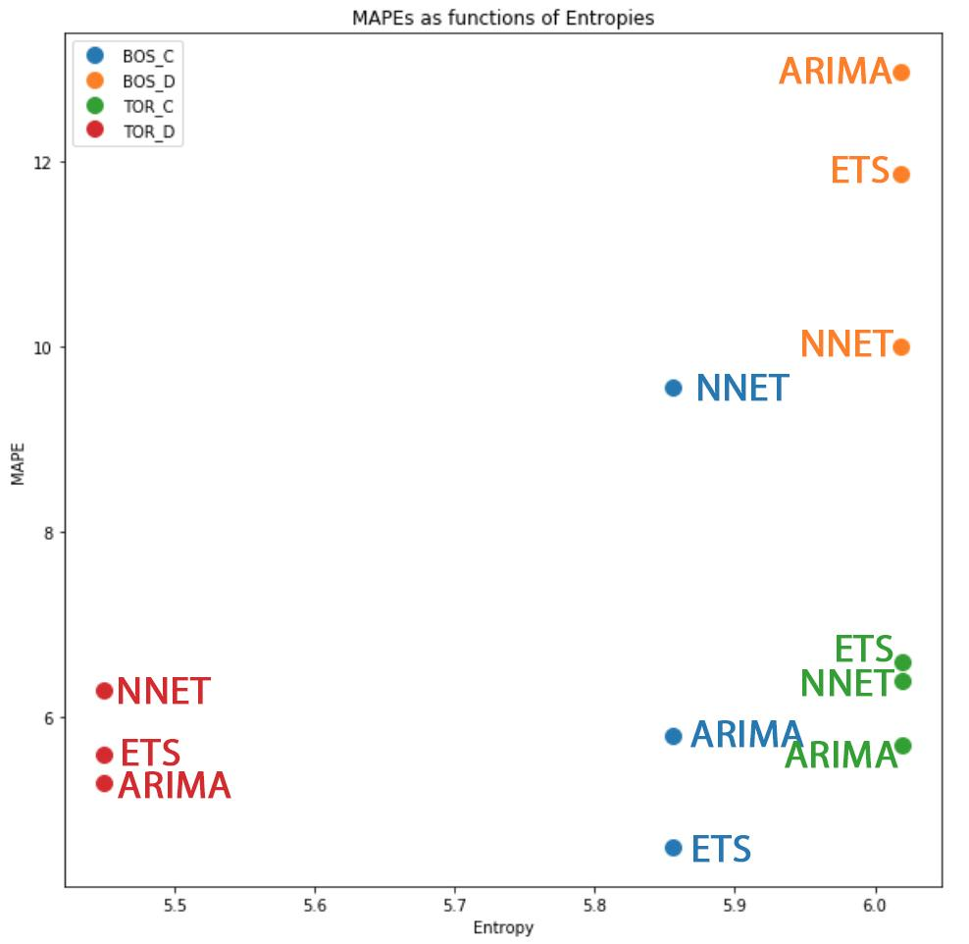
Entropy-conscious accuracy comparisons

Slide 30
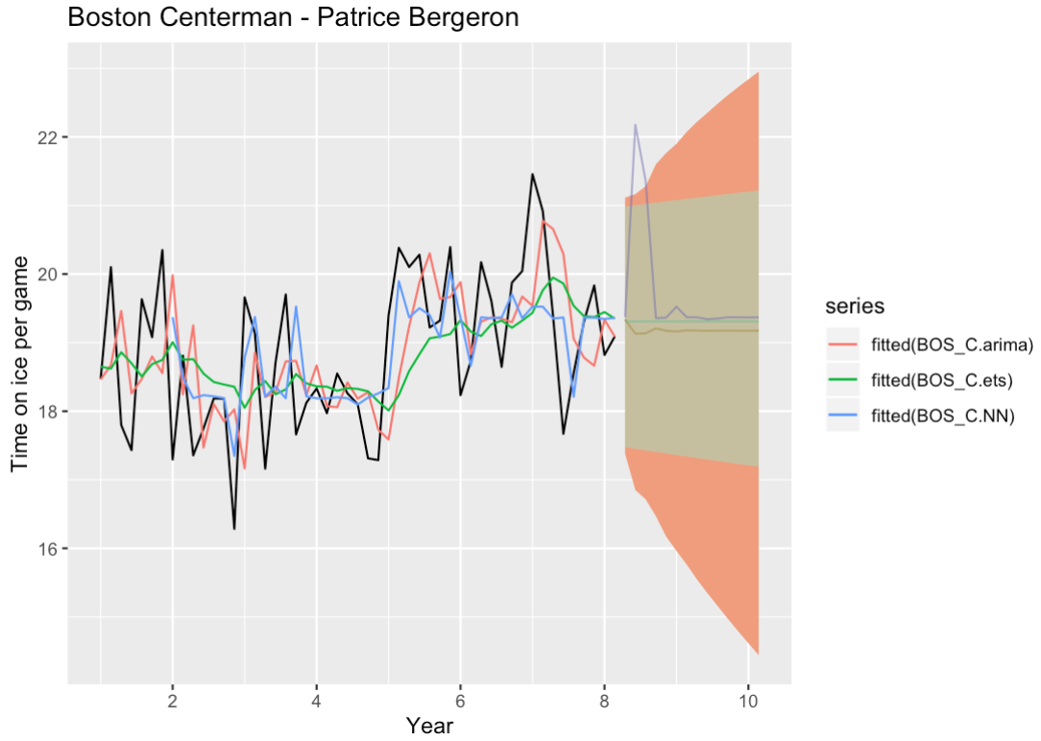
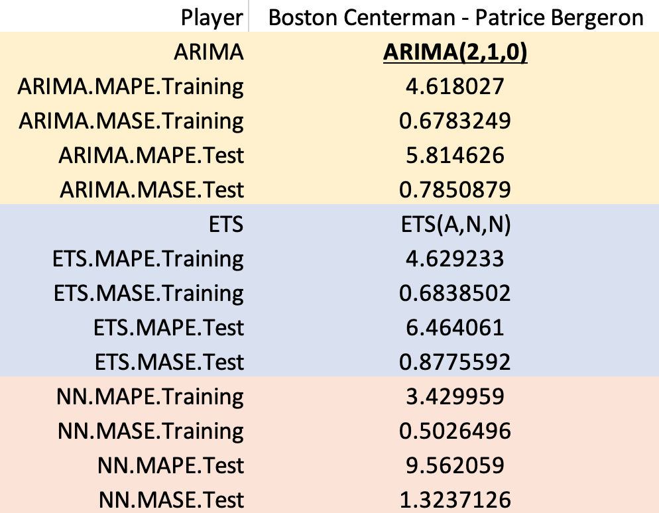
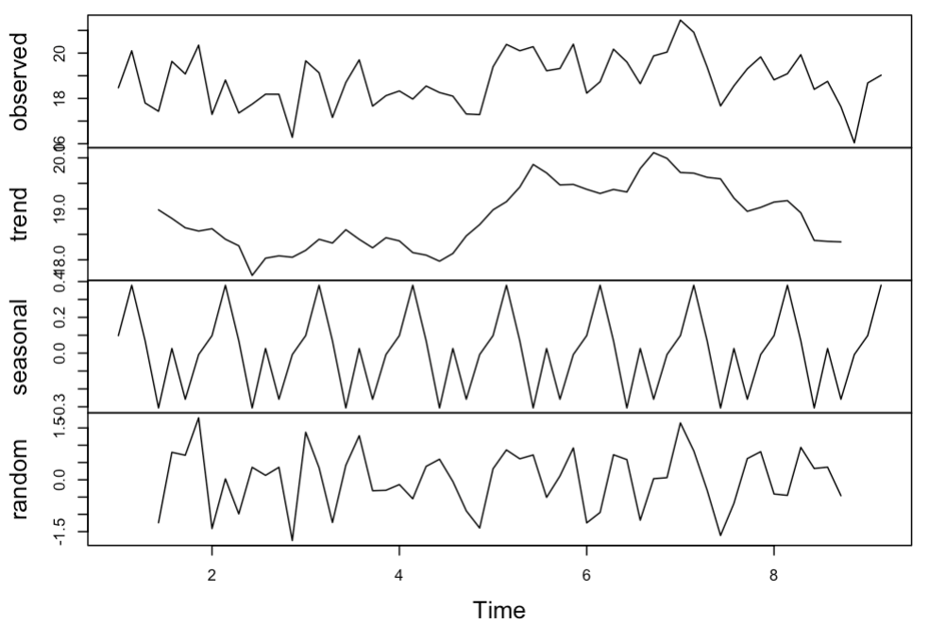
18 ~ 20 min per game
Estimated time on ice
PERFORMANCE FORECAST
KEEP the same contract!
Notes:
allstar
play well off and den
transition player
at begaining high prospective head injures

Slide 31

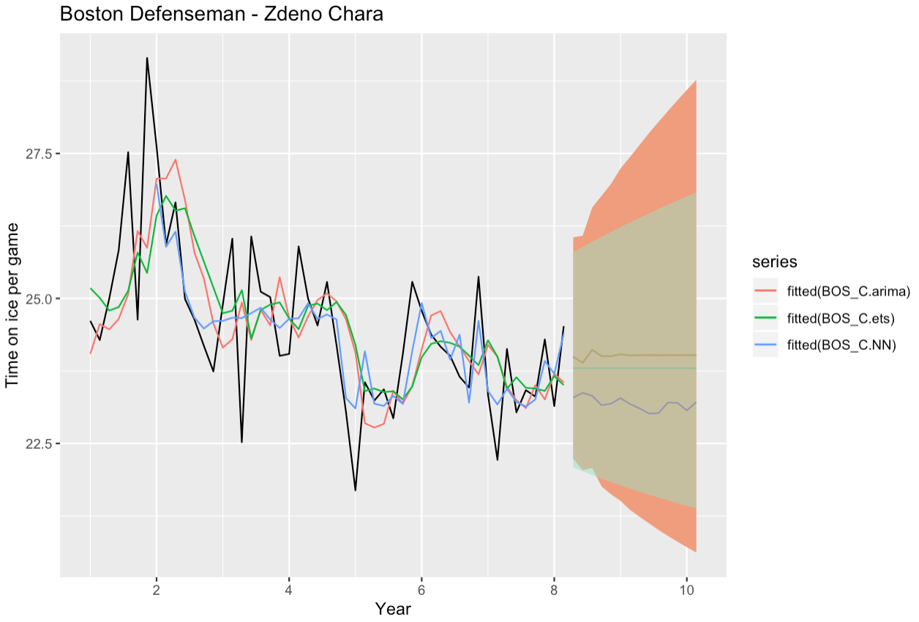
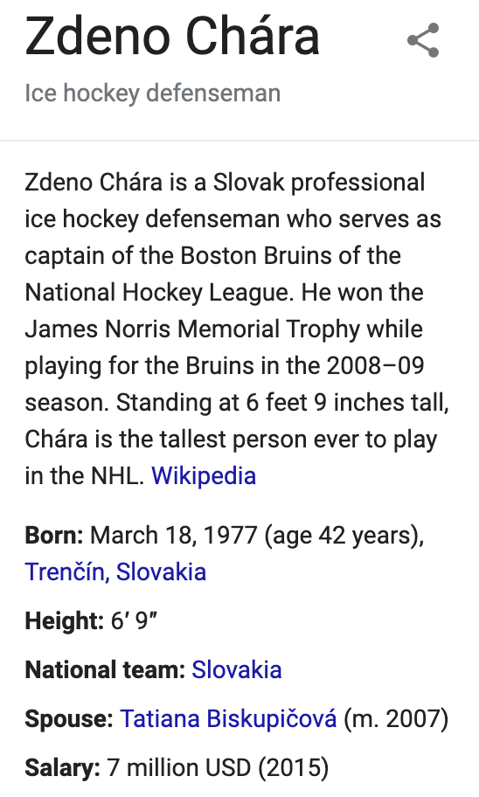
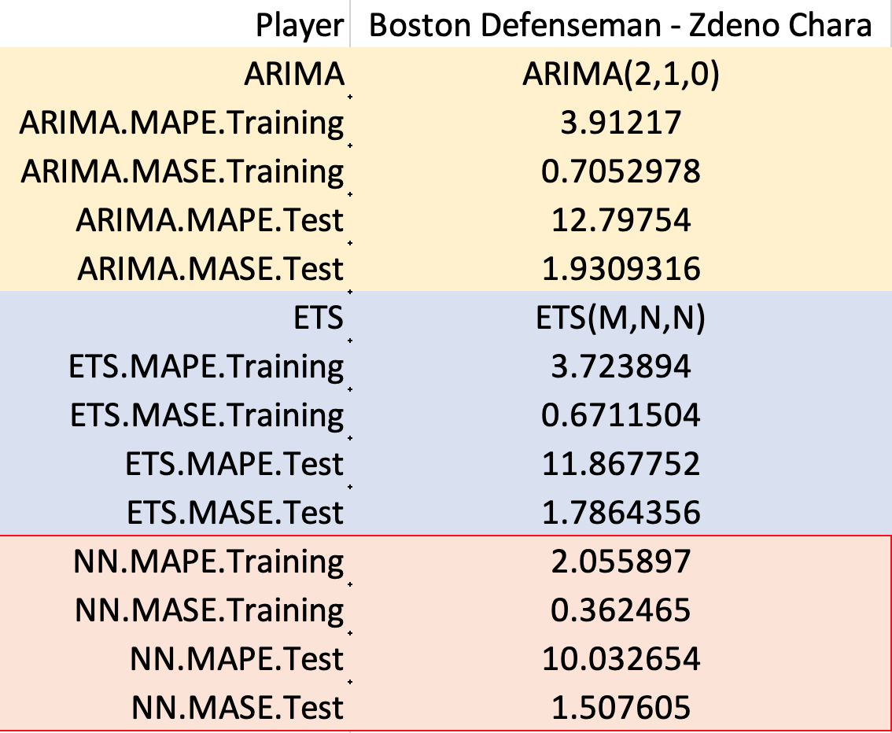
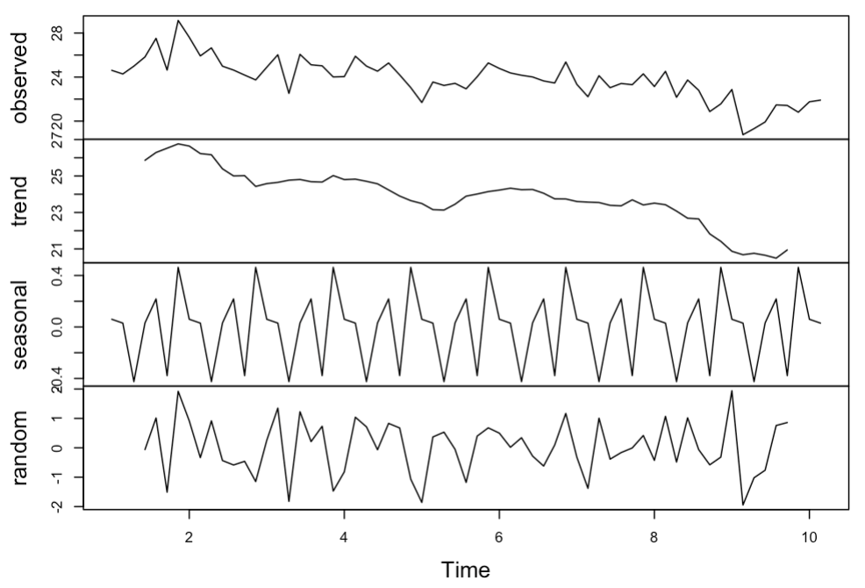
22 ~ 24 min per game
Estimated time on ice
PERFORMANCE FORECAST
REDUCE contract amount!
Notes:
allstar
goal is play all 60 mins
wasn’t very at begaining but became to be better
additicted to excersi
very good physical shape
24 years in legure

Slide 32
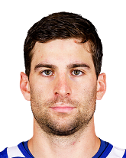

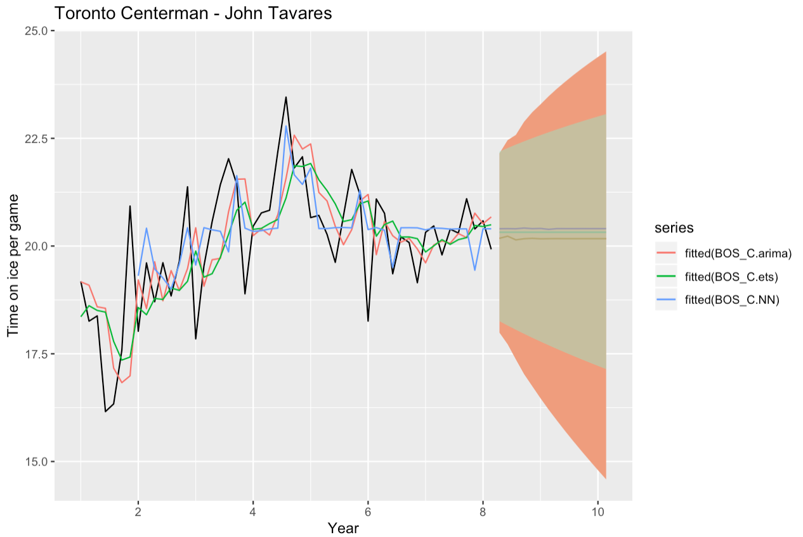
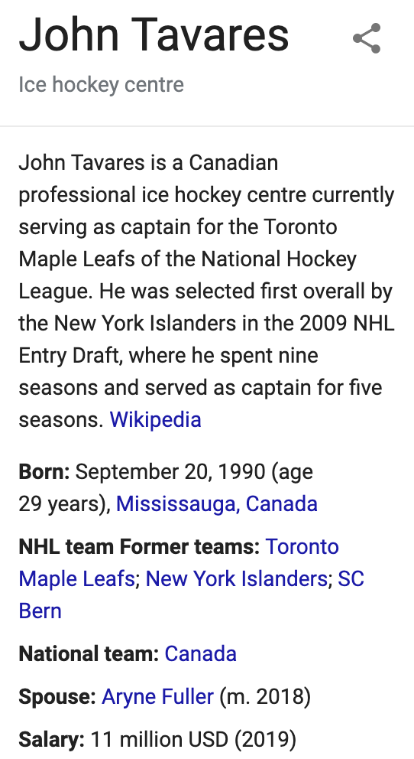
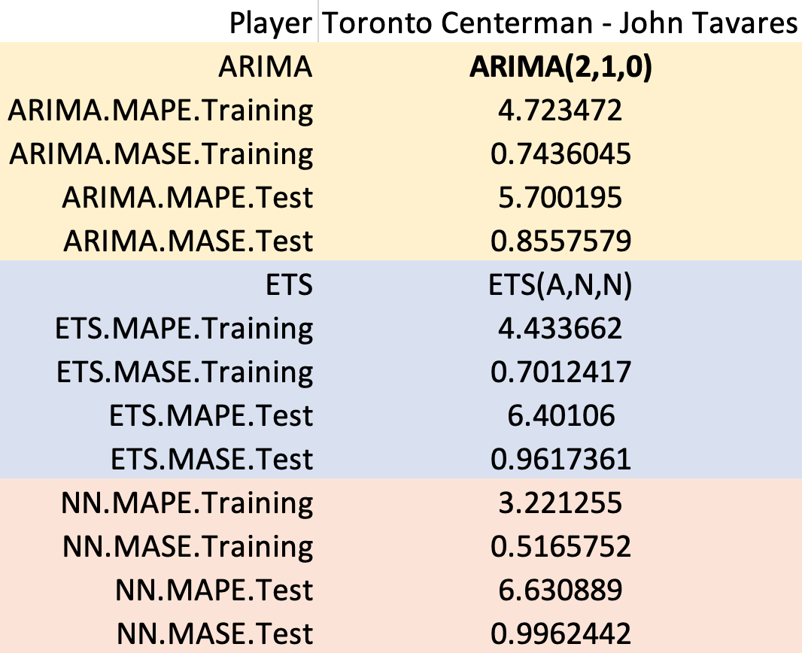

19 ~ 21 min per game
Estimated time on ice
PERFORMANCE FORECAST
KEEP the same contract!
Notes:
drafted first overall
allstar player
like bos-c
more offenci

Slide 33





20 ~ 23 min per game
Estimated time on ice
PERFORMANCE FORECAST
KEEP/REDUCE the contract!
In reality, his contract probably goes up.

Slide 34

Hockey is NOT a sport where you can reach the full picture, or even a good part of the picture, by comparing players with a single statistic.
We need to look at the breakdown of the time on ice of the players in question. How much power play and shorthanded minutes does each player put up these numbers?
As you should know instinctively, power play minutes are basically the easiest minutes to score on (especially 5 on 3s, but of course those are rares).
By contrast, penalty-killing minutes are essentially the hardest minutes to score upon.
Limitations
Notes:
2012-2013 labor dispute
Entropy went down 20% by taking an average of the year before and the year after and imputing the two missing quarters
No outliers. Despite the league’s reputation for parity, somehow the Bruins have been outperforming the league on average.

Slide 35

Use Bagging method to predict pts% next quarter
Different models applied for different players with dissimilar performance pattern
Much more can be explored, This is only a tip of an iceberg!
Conclusion

Slide 36

Questions

